Slide 1
Indeed Jobs
Data Science
Australia and USA

Slide 2
Scraping
Scraped by location, experience level, and salary.
Some searches ended up with more than 100 pages.
Doing it for all locations took too long.
Retreived the company, title, job summary, post time, location, and salary bounds if they existed.
Ended up with 7000 jobs.

Slide 3
Data Cleaning
Turned company, location, and experience level into dummy variables.
Kept only companies and locations with 5 or more occurrences.
Turned the description and title into normalized word frequency counts.
Added a boolean variable for if the salary was displayed.

Slide 4
Analysis
Did a logistic regression CV on all variables, predicting whether or not salary was greater than 100k.
Post time was positive, meaning that the longerr the job had been there for the higher the salary. This makes sense.
Salary shown was negative, meaning that high paying jobs are less likely to show salary.

Slide 5
Coefficients
Counterintuitively, mid level has the highest, followed by senior and entry which was negative.
Top companies: centers for disease control and prevention, capital one.
Worst: home depot
Top locations: In California, besides Oakland.
Worst: Norfolk
Sydney is at -0.7, Melbourne at +0.29

Slide 6
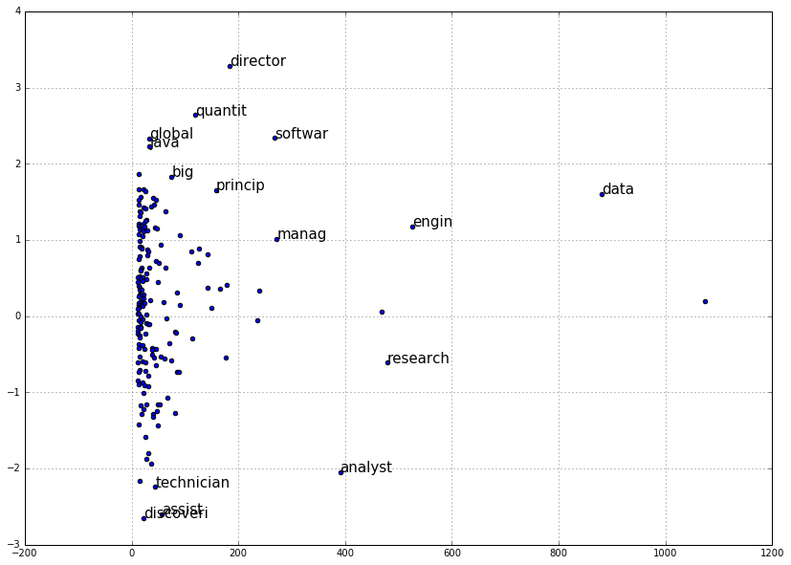
Top Words in Title

Slide 7
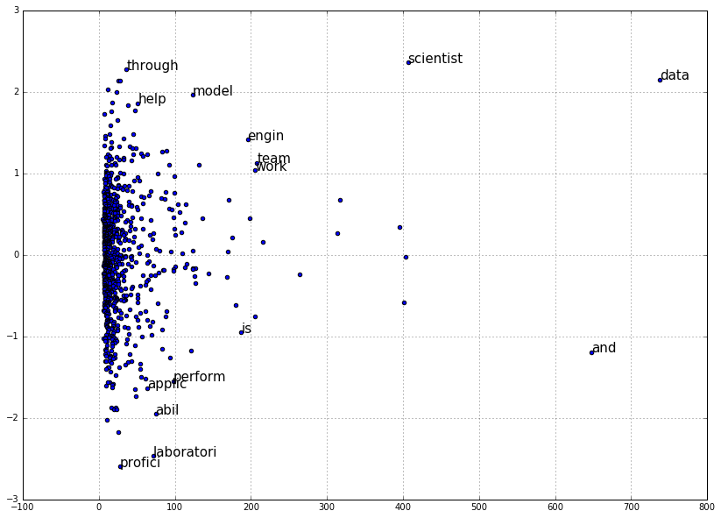
Top Words in Description

